Slide 1

Chapter 1: What Economics is About

Slide 2

In This Lesson I
  Goods and Bads and Resources
  Scarcity
  Opportunity Costs
  Costs and Benefits
  Decisions Made at the Margin
To select a topic, click on its link above

Slide 3
In This Lesson II
  Efficiency
  Incentives
  Unintended Effects
  Exchange

Slide 4
In This Lesson III
  The market and the Government
  Ceteris Paribus
  Theory
  Economic Categories

Slide 5
Building A Definition of Economics
~ Goods and Bads ~
Good - Anything from which individuals receive utility or satisfaction
Utility - The satisfaction one receives from a good
Bad - Anything from which individuals receive disutility or dissatisfaction
Disutility - The dissatisfaction one receives from a bad
Click to return to “In this Lesson”

Slide 6

Building A Definition of Economics
~ Resources ~
Land - All natural resources, such as minerals, forests, water, and unimproved land
Click to return to “In this Lesson”

Slide 7

Building A Definition of Economics
~ Resources ~
Labor - The physical and mental talents people contribute to the production process
Click to return to “In this Lesson”
Click to return to “In this Lesson”

Slide 8
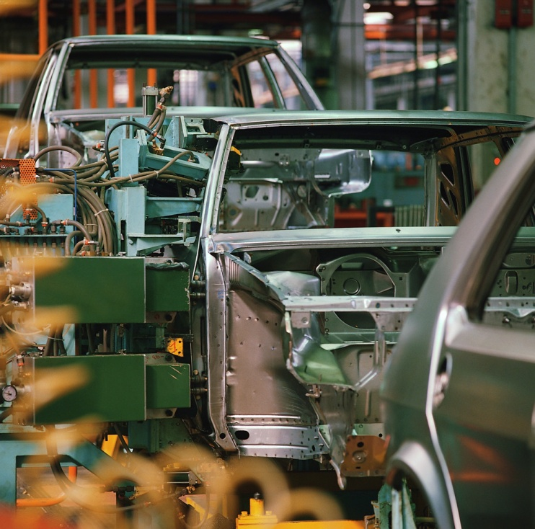
Building A Definition of Economics
~ Resources ~
Capital - Produced goods that can be used as inputs for further production, such as factories, machinery, tools, computers, and buildings
Click to return to “In this Lesson”
Click to return to “In this Lesson”

Slide 9
Building A Definition of Economics
~ Resources ~
Entrepreneurship - The particular talent that some people have for:
organizing the resources of land, labor, and capital to produce goods
seeking new business opportunities
developing new ways of doing things
Click to return to “In this Lesson”
Click to return to “In this Lesson”

Slide 10

Scarcity
The condition in which our wants are greater than the limited resources available to satisfy those wants
Click to return to “In this Lesson”
Click to return to “In this Lesson”

Slide 11
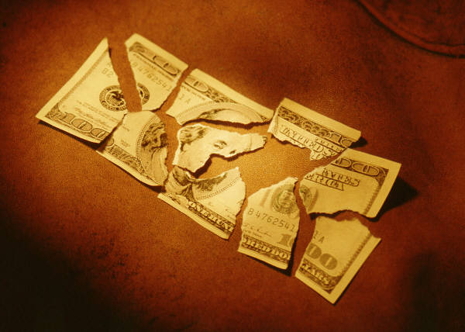
Economics, the Science of Scarcity
The science of how individuals and societies deal with the fact that wants are greater than the limited resources available to satisfy those wants.
Click to return to “In this Lesson”
Click to return to “In this Lesson”

Slide 12

Scarcity’s Effects
The Need to Make Choices
The Need for a Rationing Device
Competition
Click to return to “In this Lesson”
Click to return to “In this Lesson”

Slide 13

Rationing Device
A rationing device is a means of deciding who gets what of available resources and goods. An example of a rationing device would be the ‘dollar price’. The people who pay the dollar price for a new car end up with one
Click to return to “In this Lesson”
Click to return to “In this Lesson”

Slide 14
Self Test
1. Scarcity is the condition of finite resources. True or false? Explain your answer.
False. It takes two things for scarcity to exist: finite resources and infinite wants. If people’s wants were equal to or less than the finite resources available to satisfy their wants, there would be no scarcity. Scarcity exists only because people’s wants are greater than the resources available to satisfy their wants. Scarcity is the condition of infinite wants clashing with finite resources.
Click to return to “In this Lesson”
Click to return to “In this Lesson”

Slide 15
Self Test
2. How does competition arise out of scarcity?
Because of scarcity, there is a need for a rationing device. People will compete for the rationing device. For example, if dollar price is the rationing device, people will compete for dollars.
Click to return to “In this Lesson”

Slide 16
Self Test
3. How does choice arise out of scarcity?
Because our unlimited wants are greater than our limited resources—that is, because scarcity exists—some wants must go unsatisfied. We must choose which wants we will satisfy and which we will not.
Click to return to “In this Lesson"

Slide 17

Opportunity Costs
The most highly valued opportunity or alternative forfeited when a choice is made.
Economists believe that a change in opportunity cost can change a person’s behavior.
The higher the opportunity cost of doing something, the less likely it will be done.
Click to return to “In this Lesson”
Click to return to “In this Lesson”

Slide 18
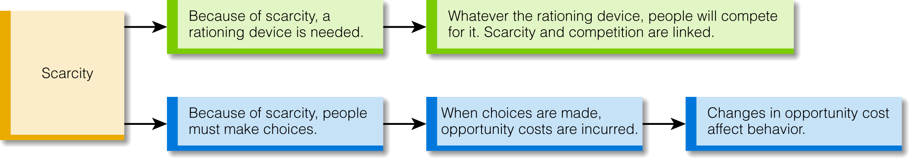
Scarcity, Choice and Opportunity Costs
Click to return to “In this Lesson”
Click to return to “In this Lesson”

Slide 19
Marginal Benefits
Additional benefits. The benefits connected to consuming an additional unit of a good or undertaking one more unit of an activity.
Click to return to “In this Lesson”
Click to return to “In this Lesson”

Slide 20
Marginal Costs
Additional costs. The costs connected to consuming an additional unit of a good or undertaking one more unit of an activity.
Click to return to “In this Lesson”
Click to return to “In this Lesson”

Slide 21
Decisions at the Margin
Decision making characterized by weighing the additional (marginal) benefits of a change against the additional (marginal) costs of a change with respect to current conditions
Click to return to “In this Lesson”
Click to return to “In this Lesson”

Slide 22

Study or Play
Cost
Benefit
Click to return to “In this Lesson”
Click to return to “In this Lesson”

Slide 23
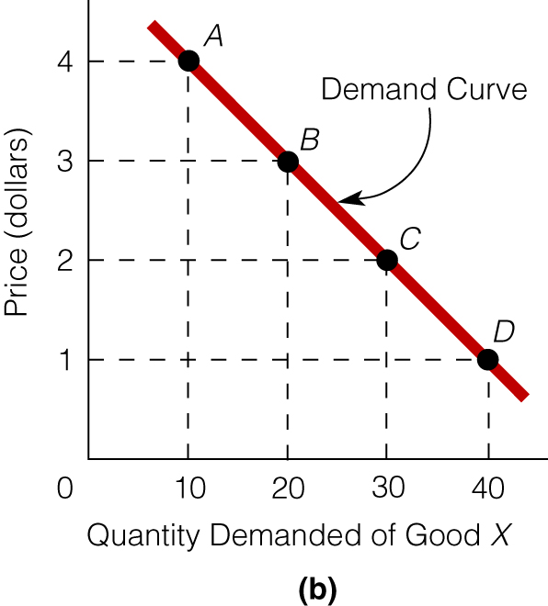
Graphing Workshop
Working with Graphs
Click graph to watch tutorial
Click to return to “In this Lesson”
Click to return to “In this Lesson”

Slide 24
Efficiency
MB = marginal benefits and MC = marginal costs. In the exhibit, the MB curve of studying is downward sloping and the MC curve of studying is upward sloping. As long as MB > MC, the person will study. The person stops studying when MB = MC. This is where efficiency is achieved.
Click to return to “In this Lesson”
Click to return to “In this Lesson”

Slide 25

Incentives
Something that encourages or motivates a person to take an action.
Click to return to “In this Lesson”
Click to return to “In this Lesson”

Slide 26
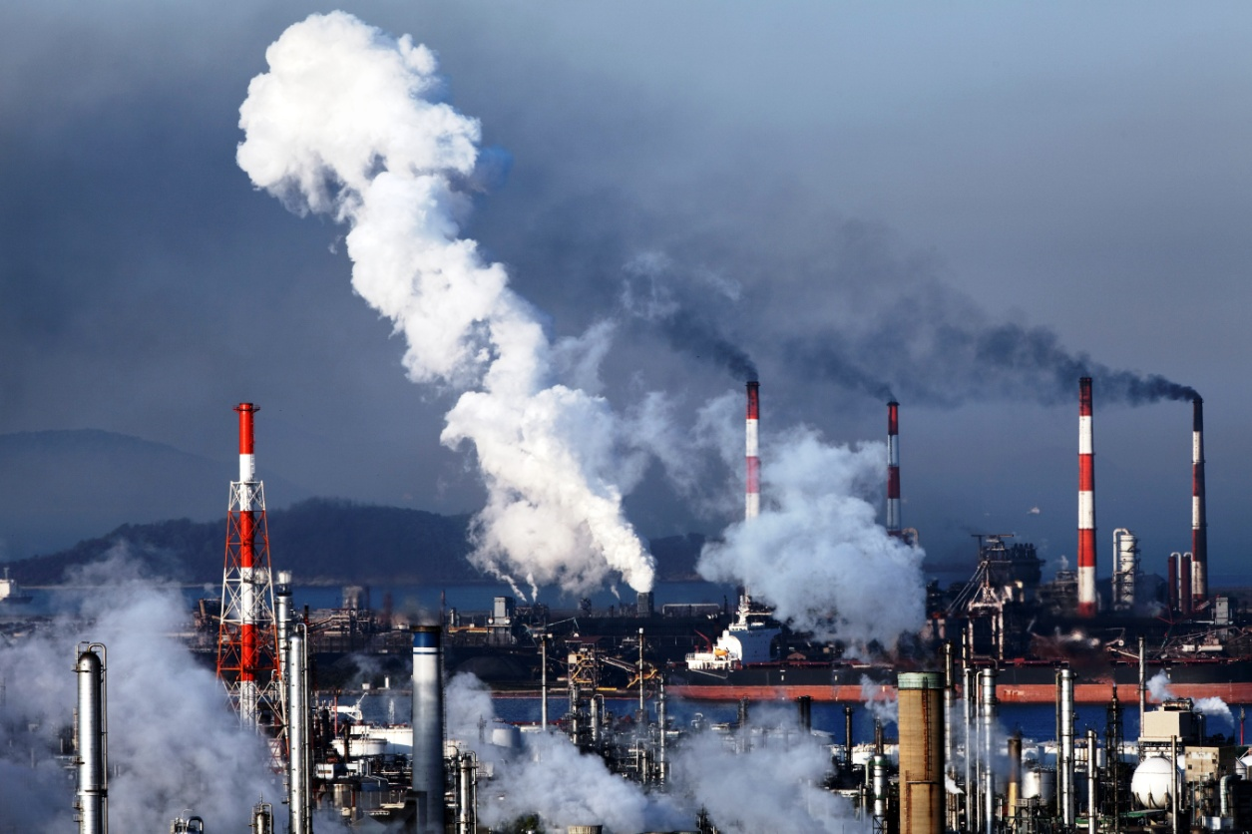
Unintended Effects
A positive or negative outcome that was not anticipated
Click to return to “In this Lesson”
Click to return to “In this Lesson”

Slide 27

Exchange/Trade
The process of giving up one thing for another.
Click to return to “In this Lesson”
Click to return to “In this Lesson”

Slide 28
Self Test
1. Give an example to illustrate how a change in opportunity cost can affect behavior.
A. Every time a person is late to history class, the instructor subtracts one-tenth of a point from the person’s final grade. If the instructor raised the opportunity cost of being late to class—by subtracting one point from the person’s final grade—economists predict there would be fewer persons late to class. In summary, the higher the opportunity cost of being late to class, the less likely people will be late to class.
Click to return to “In this Lesson”
Click to return to “In this Lesson”

Slide 29
Self Test
2. Studying has both costs and benefits. If you continue to study (say, for a test) as long as the marginal benefits of studying are greater than the marginal costs and stop studying when the two are equal, will your action be consistent with having maximized the net benefits of studying? Explain your answer.
Yes. To illustrate, suppose the marginal benefits and costs (in dollars) are as follows for various hours of studying. (see next slide)
Click to return to “In this Lesson”
Click to return to “In this Lesson”

Slide 30
Self Test
Hours Marginal Benefits Marginal Costs
First hour $20.00 $10.00
Second hour $14.00 $11.00
Third hour $13.00 $12.00
Fourth hour $12.10 $12.09
Fifth hour $11.00 $13.00
Clearly, you will study the first hour because the marginal benefits are greater than the marginal costs. In this case, you will study through the fourth hour.
You will not study the fifth hour because it is not worth it; the marginal benefits of studying the fifth hour are less than the marginal costs. In short, there is a net cost to studying the fifth hour. (next slide)
Click to return to “In this Lesson”
Click to return to “In this Lesson”

Slide 31
Self Test
Stated differently, there is a net benefit of $10 (the difference between the marginal benefits of $20 and the marginal costs of $10) for studying the first hour. If you stop studying after the first hour and do not proceed to the second, then you will forfeit the net benefit of $3 for the second hour. To maximize your net benefits of studying, you must proceed until the marginal benefits and the marginal costs are as close to equal as possible. (In the extreme, this is an epsilon away from equality. However, economists simply speak of “equality” between the two for convenience.)
Click to return to “In this Lesson”

Slide 32
Self Test
3. You stay up an added hour to study for a test. The intended effect is to raise your test grade. What might be an unintended effect of staying up an added hour to study for the test?
You might feel sleepy the next day, you might be less alert while driving, and so on.
Click to return to “In this Lesson”
Click to return to “In this Lesson”

Slide 33
The Market and Government
Addressing Issues
Financial problems in the banking sector
The economic effects of falling real estate prices
Growing federal budget deficits
A fall in economic activity, as measured by the total output of goods and services produced in the country
Rising unemployment
The looming crisis in Social Security
Health-care issues
Issues related to climate change and the environment
The proper role of monetary policy
The proper role of government regulatory policy in the economy, and much more
Click to return to “In this Lesson”
Click to return to “In this Lesson”

Slide 34
The Market and Government
When it comes to economic problems, the national debate usually proceeds along these lines:
• First, the problem is identified and defined or described.
• Second, individuals attempt to identify the cause of the problem.
• Third, individuals propose solutions to the problem.
Click to return to “In this Lesson”
Click to return to “In this Lesson”

Slide 35
The Market and Government
With respect to both the cause and the solution, we often hear two words mentioned: the “market” and “government.”
• Either: The market (or capitalism) is the cause of the problem.
• Or: The government is the cause of the problem.
• Either: The market (or capitalism) is the solution to the problem.
• Or: The government is the solution to the problem.
Click to return to “In this Lesson”

Slide 36
Ceteris Paribus
A Latin term meaning “all other things constant” or “nothing else changes.”
Ceteris paribus is an assumption used to
examine the effect of one influence on an
outcome while holding all other influences constant.
Click to return to “In this Lesson”
Click to return to “In this Lesson”

Slide 37

Theory
Economists build theories to answer questions that do not have obvious answers.
Cause
Effect
Theory is an abstract representation of the real world designed with the intent to better understand the world.
Click to return to “In this Lesson”
Click to return to “In this Lesson”

Slide 38
Abstract
The process (used in building a theory) of focusing on a limited number of variables to explain or predict an event.
Click to return to “In this Lesson”
Click to return to “In this Lesson”

Slide 39
Self Test
What is the purpose of building a theory?
The purpose of building a theory is to explain something that is not obvious. For example, the cause of changes in the unemployment rate is not obvious, and so the economist would build a theory to explain changes in the unemployment rate.
Click to return to “In this Lesson”
Click to return to “In this Lesson”

Slide 40
Self Test
How might a theory of the economy differ from a description of it?
A theory of the economy seeks to explain why certain things in the economy happen. For example, a theory of the economy might try to explain why prices rise or why output falls. A description of the economy is simply a statement of what exists in the economy. For example, we could say that the economy is growing or contracting or that more jobs are available this month than last month. A description doesn’t answer questions; it simply tells us what is. A theory tries to answer a why question, such as, “Why are more jobs available this month than last month?”
Click to return to “In this Lesson”
Click to return to “In this Lesson”

Slide 41
Self Test
3. Why is it important to test a theory? Why not simply accept a theory if it sounds right?
If you do not test a theory, you will never know whether you have accomplished your objective in building the theory in the first place. In other words, you will not know if you have accurately explained something. We do not simply accept a theory if it sounds right because what sounds right may actually be wrong. For example, no doubt during the time of Columbus, the theory that the earth was flat sounded right to many people and the theory that the earth was round sounded ridiculous. The right-sounding theory turned out to be wrong, though, and the ridiculous-sounding theory turned out to be right.
Click to return to “In this Lesson”
Click to return to “In this Lesson”

Slide 42
Self Test
Your economics instructor says, “If the price of going to the movies goes down, people will go to the movies more often.” A student in class says, “Not if the quality of the movies goes down.” Who is right, the economics instructor or the student?
Unless stated otherwise, when economics instructors identify the relationship between two variables, they implicitly make the ceteris paribus assumption. In other words, the instructor is really saying, “If the price of going to the movies goes down, people will go to the movies more often—assuming that nothing else changes, such as the quality of movies, and so on.” (continued on next slide)
Click to return to “In this Lesson”
Click to return to “In this Lesson”

Slide 43
Self Test (continued)
Instructors don’t always state “ceteris paribus” because if they did, they would be using the term every minute of a lecture. So the instructor is right, although a student new to economics might not know what the instructor is assuming but not saying.
Click to return to “In this Lesson”
Click to return to “In this Lesson”

Slide 44
Economic Categories
Positive vs. Normative Economics
Positive - The study of “what is” in economic matters.
Cause Effect
Normative - The study of “what should be” in economic matters
Judgment and Opinion
Click to return to “In this Lesson”
Click to return to “In this Lesson”

Slide 45

Economic Categories
Microeconomics
Microeconomics deals with human behavior and choices as they relate to relatively small units—an individual, a business firm, an industry, a single market.
Click to return to “In this Lesson”

Slide 46
Microeconomic Questions
How does a market work?
What level of output does a firm produce?
What price does a firm charge for the good it produces?
How does a consumer determine how much of a good he or she will buy?
Can government policy affect business behavior?
Can government policy affect consumer behavior?
Click to return to “In this Lesson”
Click to return to “In this Lesson”

Slide 47
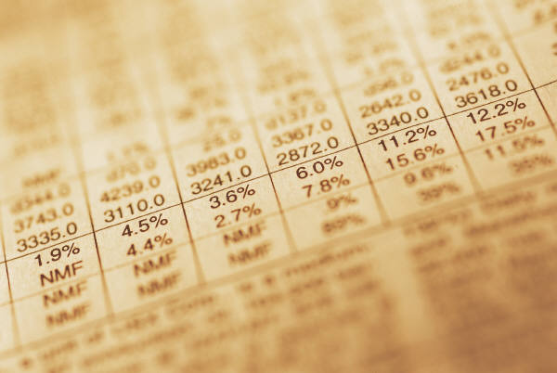
Economic Categories Macroeconomics
Macroeconomics deals with human behavior and choices as they relate to highly aggregate markets (e.g., the goods and services market) or the entire economy.
Click to return to “In this Lesson”
Click to return to “In this Lesson”

Slide 48
Macroeconomic Questions
How does the economy work?
Why is the unemployment rate sometimes high and sometimes low?
What causes inflation?
Why do some national economies grow faster than other national economies?
What might cause interest rates to be low one year and high the next?
How do changes in the money supply affect the economy?
How do changes in government spending and taxes affect the economy?
Click to return to “In this Lesson”

Slide 49

Wall Street Journal
The Wall Street Journal is a is a rich source of information which provides real life examples of micro- and macro economic activities. Check today’s issue to see the most current news.
http://www.wsj.com

Slide 50
Other Useful Sources of Current Economic News
New York Times
http://www.nytimes.com/pages/business/index.html
Financial Times
http://www.ft.com/home/us
The Economist
http://www.economist.com/index.html

